Slide 1

Women Against Crime: Predictive Analysis System Overview
In response to the rising concerns around crimes against women, data-driven approaches are critical to enhancing prevention strategies. This project aims to develop a robust predictive analysis system focused specifically on forecasting crimes targeting women.
Leveraging powerful tools such as Python, machine learning algorithms, and Power BI dashboards, the system integrates multiple data sources to provide actionable insights for law enforcement and communities. The initiative exemplifies the importance of technology in creating safer environments.
MH
by Muskan Hassan

Slide 2
Data Acquisition and Preprocessing with Python
Data Sources
Preprocessing Techniques
Libraries Used
We utilize publicly available datasets including FBI crime reports and local police department records, enriched by demographic information to ensure comprehensive analysis.
Data cleaning involves removing inaccuracies and handling missing values. Feature engineering converts raw data into meaningful formats, such as transforming timestamps into cyclical features representing time of day.
Pandas and NumPy serve as the backbone for efficient data manipulation, enabling seamless handling of large-scale datasets suitable for predictive modeling.

Slide 3
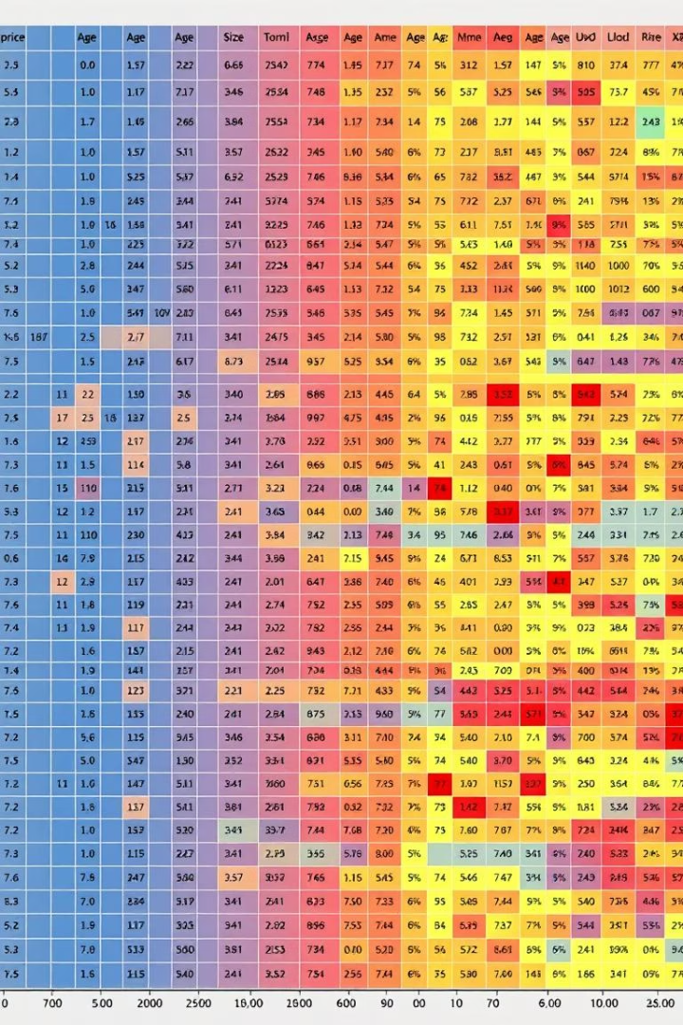
Feature Selection and Engineering
Key Features
Feature Engineering
Geographical location details
Advanced techniques create interaction and polynomial features to reveal complex relationships impacting crime prediction accuracy.
Time of day and day of week
Socio-economic indicators
Historical crime data
Selection Methods
Scikit-learn tools are applied to identify the most relevant features, enhancing model performance by reducing noise and redundancy.

Slide 4

Machine Learning Model Development
Models Explored
Selection Criteria
Frameworks Used
Logistic Regression, Random Forest, Support Vector Machines, and Gradient Boosting were considered for their balance between accuracy and interpretability.
Model choice was driven by predictive accuracy, computational efficiency, and the ability to explain results to stakeholders.
Scikit-learn facilitated model training, evaluation, and validation, forming a flexible and powerful development environment.

Slide 5
Model Evaluation and Validation
Evaluation Metrics
Robust Validation
Precision to minimize false positives
10-fold cross-validation techniques ensured model generalizability and minimized overfitting risks.
Recall to detect actual crime events
F1-score balancing precision and recall
Hyperparameter tuning refined settings to optimize predictive power without unnecessary computational overhead.
AUC-ROC indicating overall model discrimination ability

Slide 6
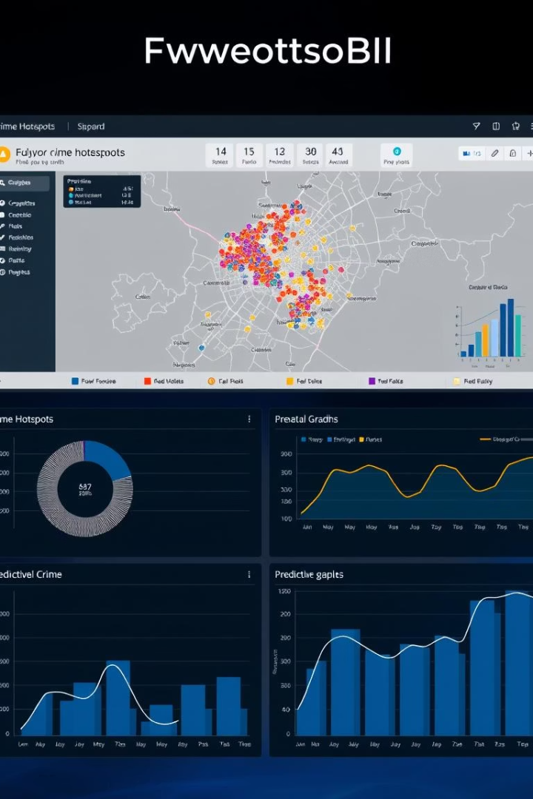



Power BI Dashboard Design
Crime Hotspots
Insightful Charts
User Accessibility
Visual geographic representation highlights high-risk areas to prioritize interventions.
Diverse graphs provide temporal and demographic insights, revealing trends and patterns.
Designed with simplicity to suit law enforcement and community members alike for effective decision-making.

Slide 7
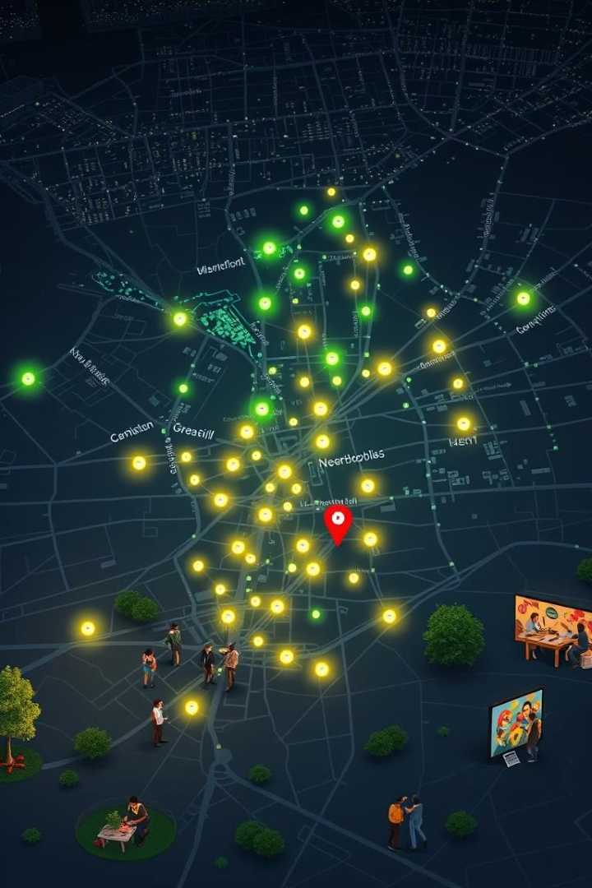
Real-World Impact and Case Studies
1
Pilot Area Success
A pilot deployment demonstrated a measurable drop in crimes against women through targeted policing informed by predictions.
2
Community Feedback
Engagement programs enhanced trust and data sharing, amplifying the system's effectiveness in real environments.
3
Ethical Approach
Ongoing monitoring addresses bias, ensuring fairness and equity in predictive outcomes.
4
Expansion Plans
Plans include scaling to additional regions and integrating with complementary surveillance and response systems.

Slide 8
Conclusion: Empowering Communities with Data
This system exemplifies how advanced data analytics and machine learning can empower communities to proactively combat crimes against women.
We invite collaboration, innovation, and continuous improvement in this vital area of public safety.
Thanks to the dedication of developers, data scientists, and community partners for making this vision a reality.
By joining technology with social initiatives, we foster safer environments and informed decision-making among law enforcement and citizens alike.

Slide 9
Thank You
We appreciate your time and attention throughout this presentation.
Together, we can make communities safer with data-driven solutions.
We look forward to collaborating on this important mission.
1
Gratitude
2
Collaboration
3
Next Steps
Thanks to everyone who contributed to this project’s success.
Partnerships are key to expanding impact and innovation.
Stay connected for updates and new opportunities to contribute.

